Slide 1
Data Description

Slide 2
Data
This folder contains 3 data sets (refer slide 3-4 for reservoir model and well locations).
Every simulation case describes a scenario where we start producing from the field using P1 producer, both injectors are active since the beginning, then after a year of production, we introduce the second producer P2, simulating a new infill well.
Injectors are at constant rate
Producers are pressure controlled
Cases numbered 1-60 we don’t change the location of P2. The difference comes from the time we introduce the well. Case 1 after 12 months, case2 after 13 months, and so on. We add one month gradually to each simulation case starting from 12 to 7.
Cases numbered 61-960 all start at the same time (same time as case 1), however, we simulate different location, we simulate every location starting from the down-left corner. Refer last slide for P2 location information.

Slide 3
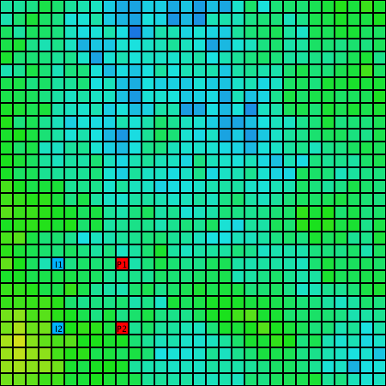
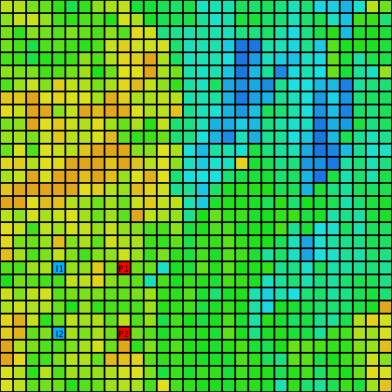
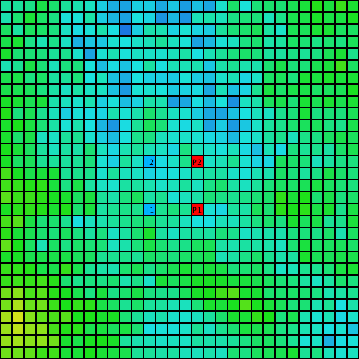
Porosity (blue is high, yellow is low)
Heterogenous Corner
Channel
Heterogenous Center
Slice of SPE 10, Z = 80
Slice of SPE 10, Z = 15
Slice of SPE 10, Z = 15

Slide 4
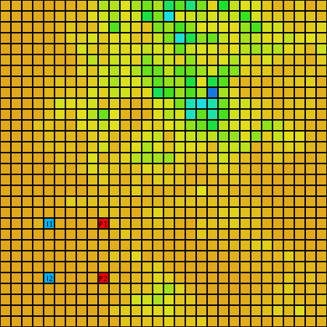
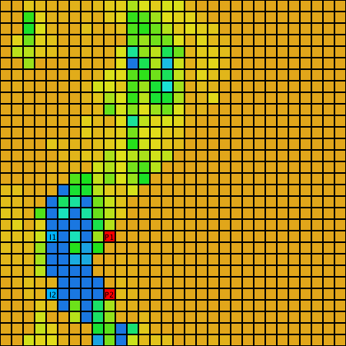
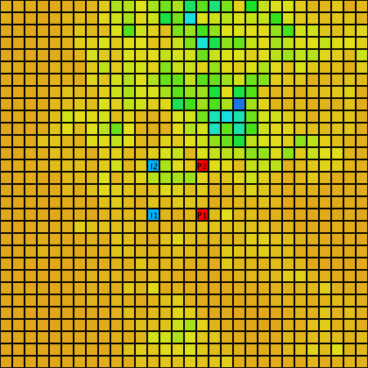
Permeability X direction (blue is high, yellow is low)
Heterogenous Corner
Channel
Heterogenous Center

Slide 5
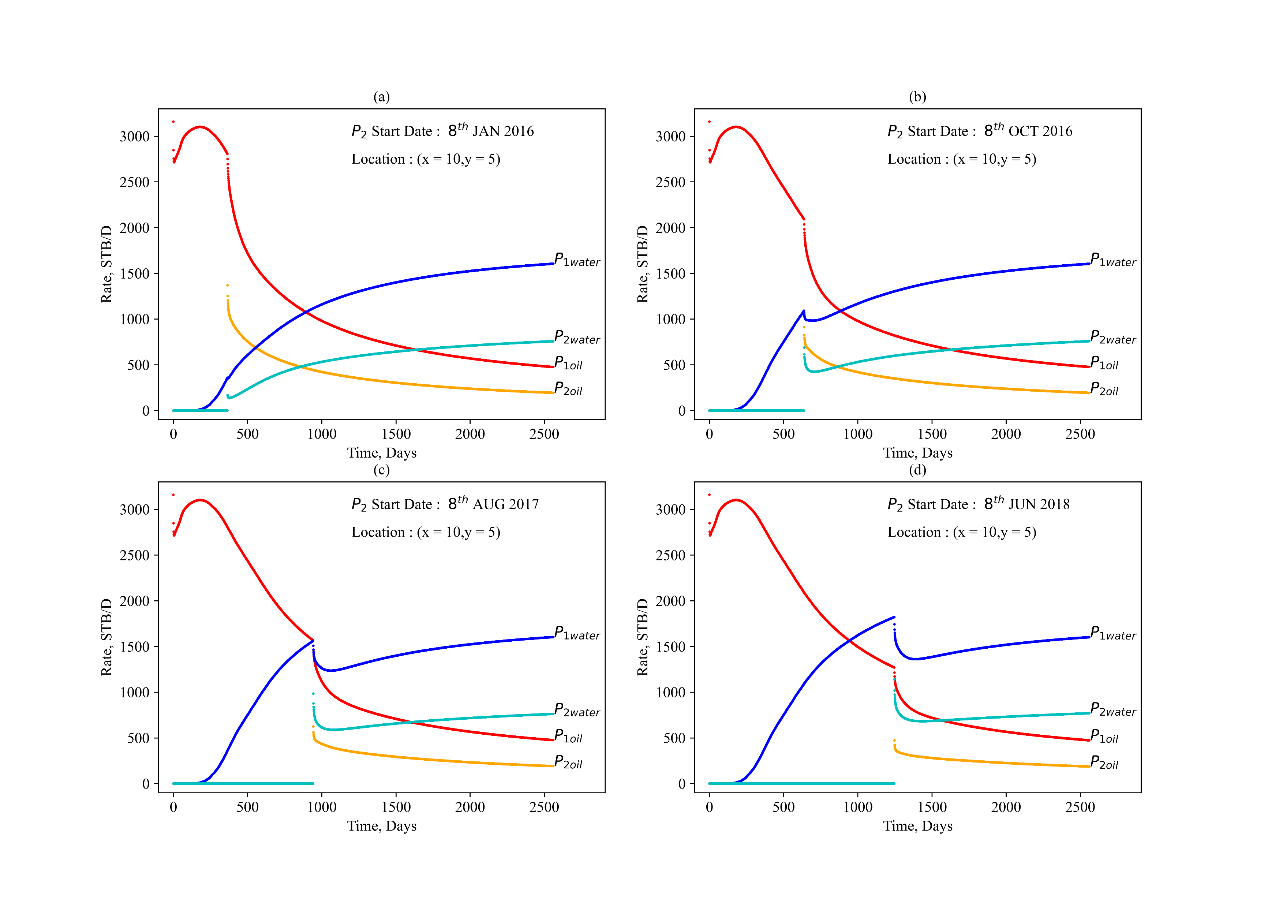
Sample outputs varying time (1-60)

Slide 6
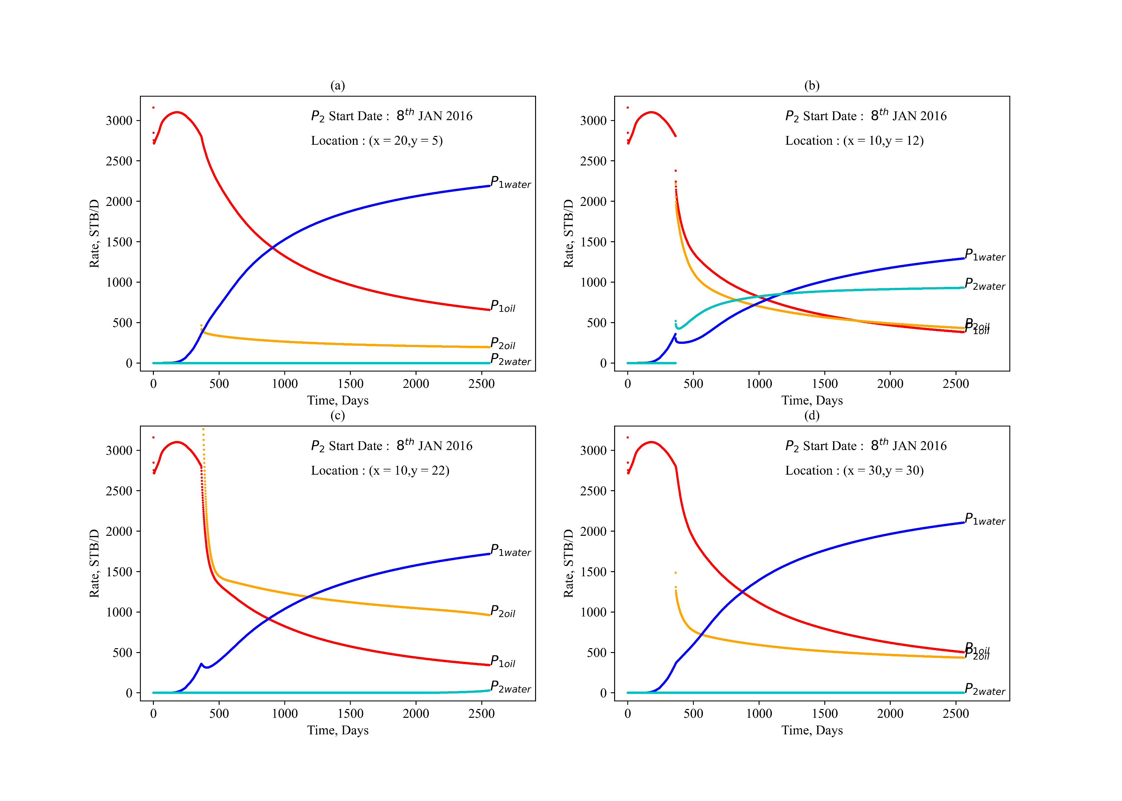
Sample outputs varying space (61-960)

Slide 7
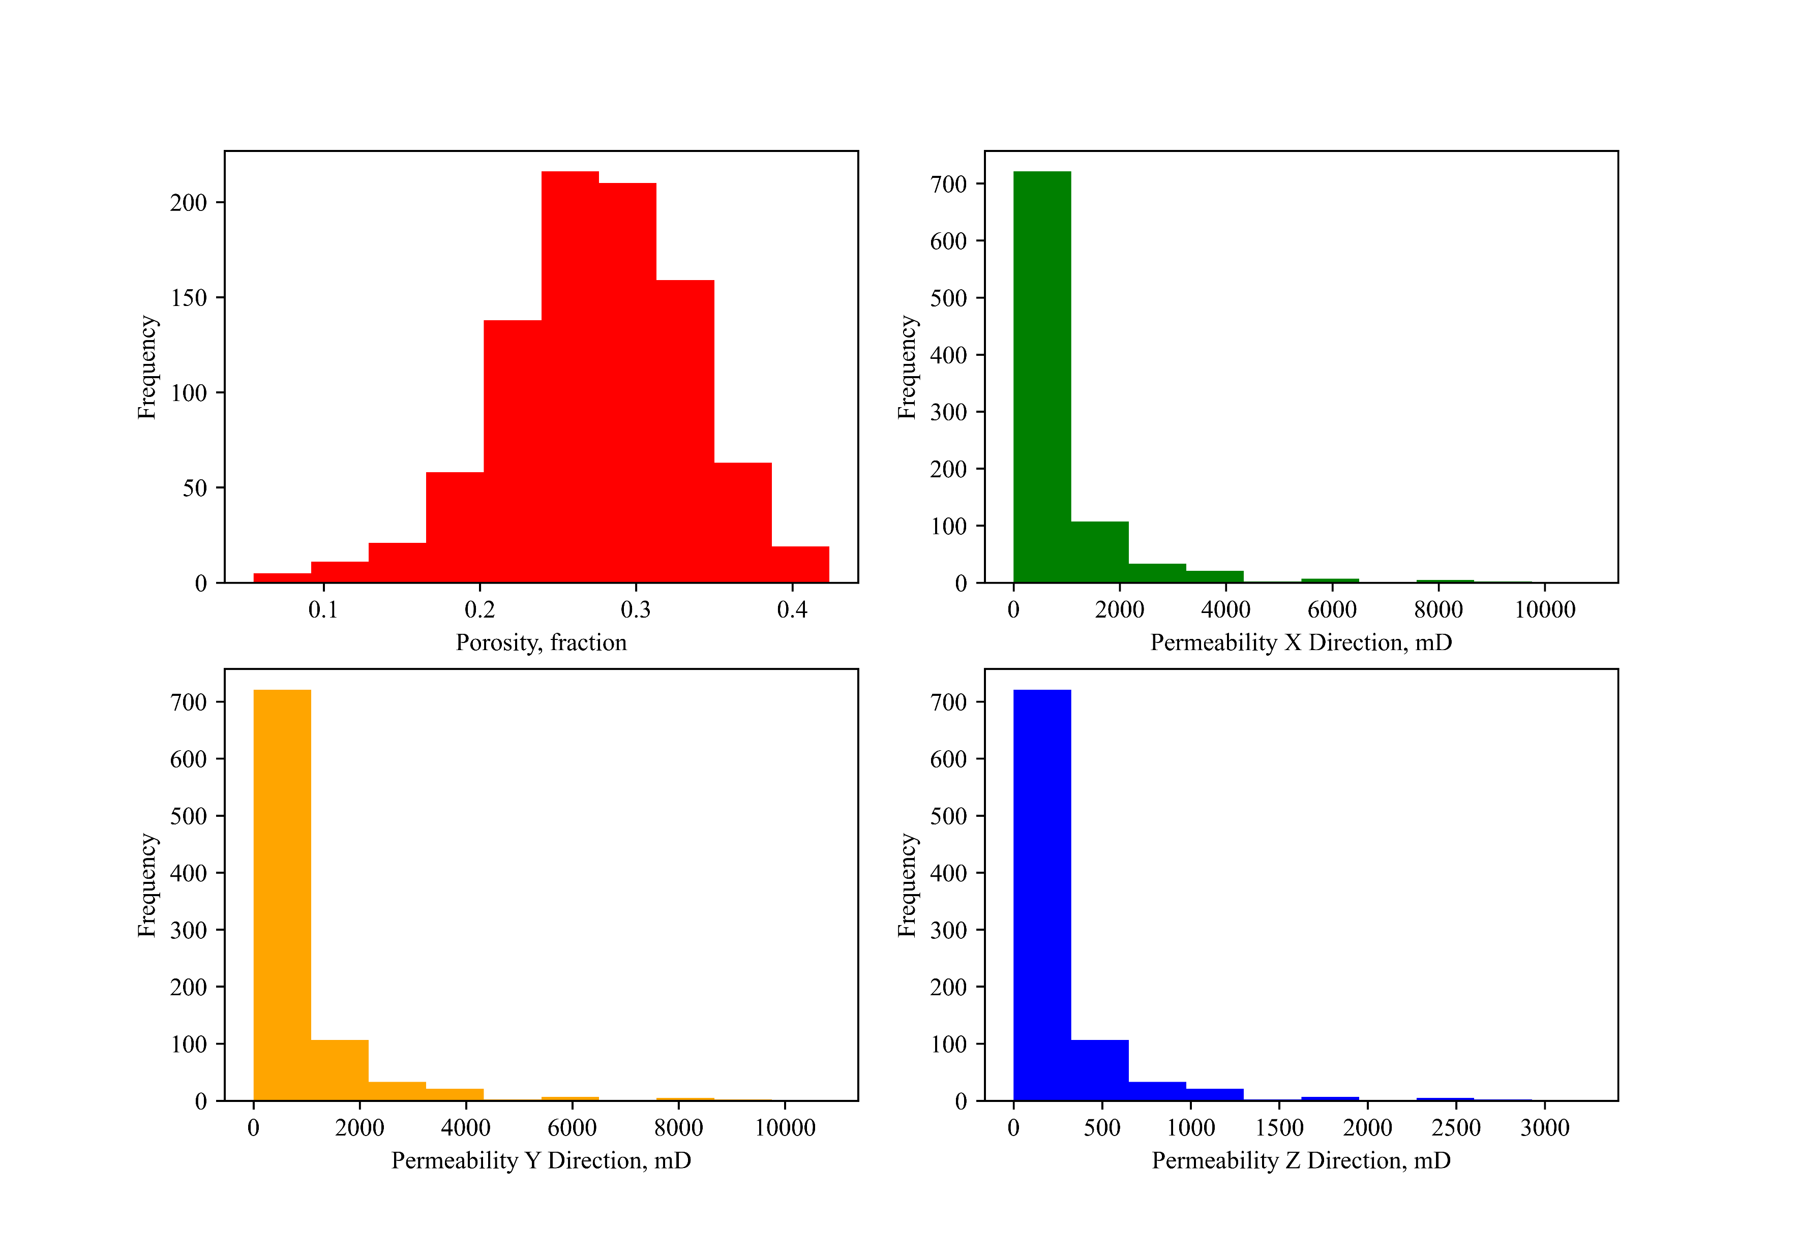
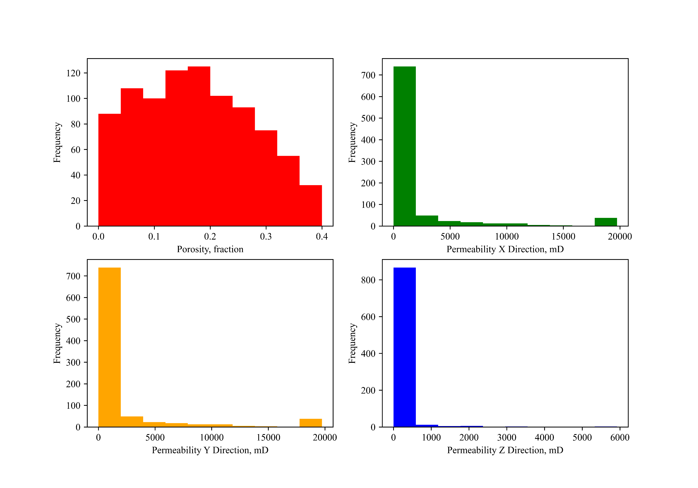
Hetrogenous left, Channel Right

Slide 8
Location for case 931
Location for case 960
Location for cases 1- 60
Location for case 91
Location for case 61
Location for case 90

